Slide 1
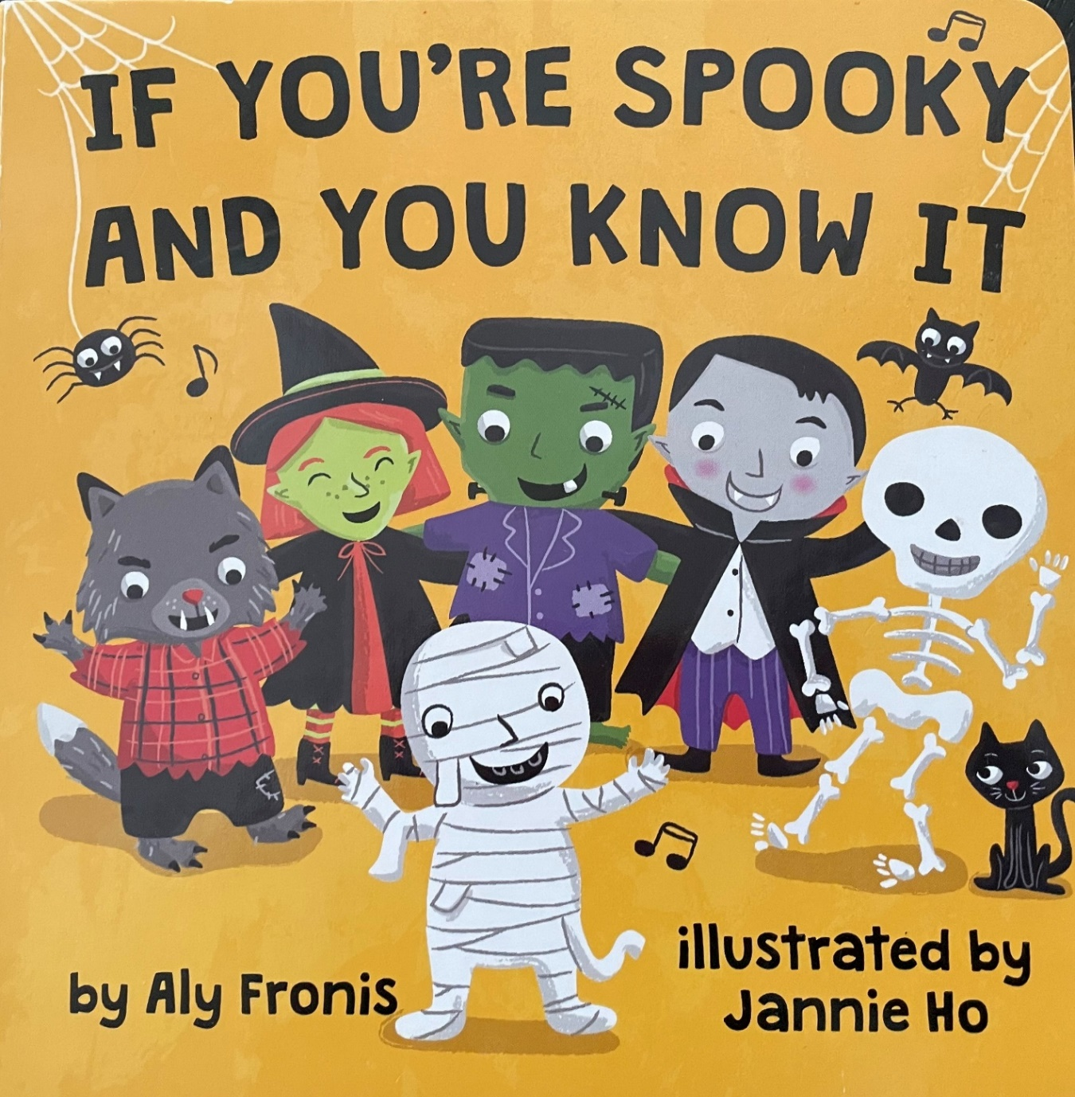
Song adaptation from:

Slide 2
Language learning in all activities
Have fun moving and dancing to this Halloween theme
Point to the visual language on the screen
Make action choice boards for student to choose which action is next
Have individual language icons available to reinforce during the activity
Students can use their speech devices to indicate the movement
Where else are these movement words heard and used?
LAMP icons © Prentke Romich Company
SymbolStix icons © PRC-Saltillo Corporation
Picture Communication Symbols (PCS) © Mayer-Johnston/Tobii Dynavox

Slide 3
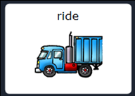
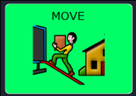
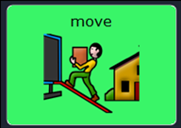
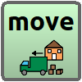
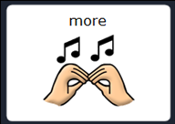
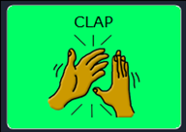
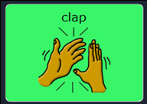
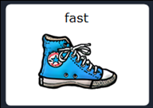
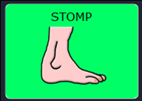
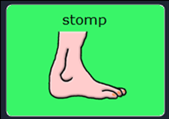
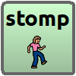
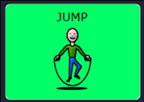
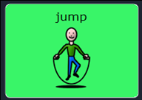
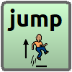
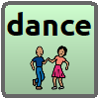
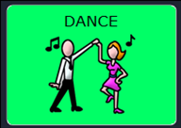
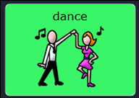
 | LAMP | Word Power (SymbolStix) | TD Snap (PCS (Boardmaker))
move
clap
stomp
jump
dance

Slide 4
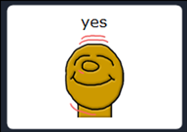
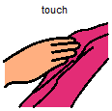
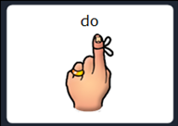
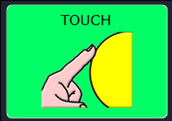
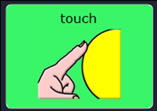
 | LAMP | Word Power (SymbolStix) | TD Snap (PCS (Boardmaker))
Yes (nod head)
Touch (honk nose)

Slide 5
If you’re spooky and you know it CLAP your hands

Slide 6
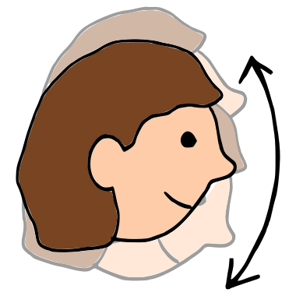
If you’re sneaky and you know it, NOD your head

Slide 7
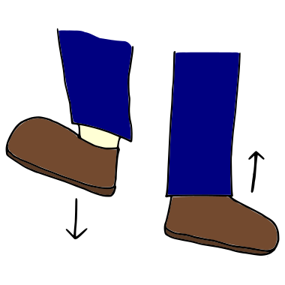
If you’re wicked and you know it STOMP your feet

Slide 8
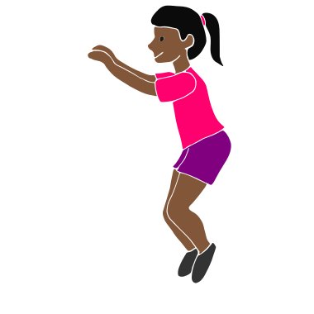
If you’re hairy and you know it JUMP up high

Slide 9
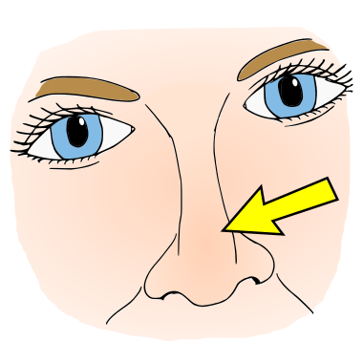
If you’re creepy and you know it HONK your nose

Slide 10
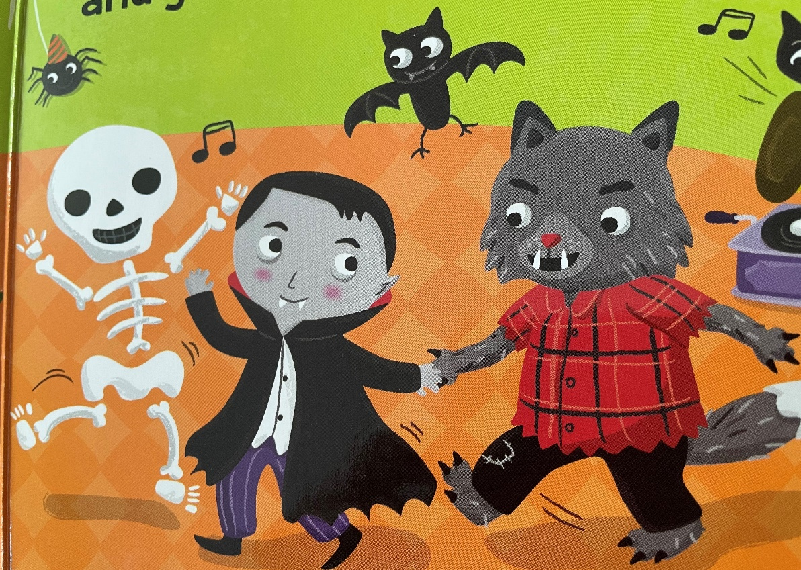
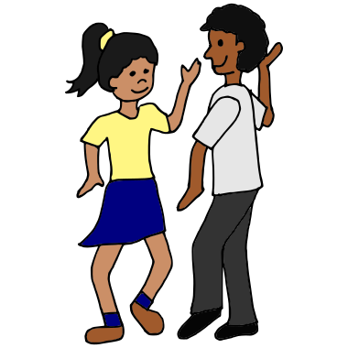
If you’re fun and you know it DANCE around

